Slide 1
New Walking-Working Surfaces and PPE (Fall Protection) Rule

Slide 2
Purpose of the New Rule
To update the outdated subpart D standard, incorporating new technology and industry practices
To increase consistency with OSHA’s construction standards (CFR 1926 subparts L, M, and X)
To add new provisions to subpart I that set forth criteria requirements for personal fall protection equipment

Slide 3
Major Changes
Fall Protection Flexibility
Updated Scaffold Requirements
Phase-in of ladder safety systems or personal fall arrest systems on fixed ladders
Phase-out of “qualified climbers” on outdoor advertising structures
Rope descent systems
Adds requirements for personal fall protection equipment (final §1910.140)
Adds training requirements

Slide 4
Organization of Subpart D
§1910.21 – Scope, Application and Definitions
§1910.22 – General Requirements
§1910.23 – Ladders
§1910.24 – Stepbolts and Manhole Steps
§1910.25 – Stairways
§1910.26 – Dockboards
§1910.27 – Scaffolds and Rope Descent Systems
§1910.28 – Duty to Have Fall Protection
§1910.29 – Fall Protection Systems Criteria and Practices
§1910.30 –Training Requirements

Slide 5
§1910.21
§1910.21 – Scope and definitions
Consolidates definitions into one section
Adds new definitions to provide clarity

Slide 6
§1910.22
§1910.22 – General Requirements
Maintains housekeeping provisions
Walking-working surfaces must be designed to meet their maximum intended load, free of recognized hazards, and routinely inspected
Repairs to be done, or overseen, by competent person

Slide 7
§1910.22
Passageways, storerooms, service rooms, and walking-working surfaces are kept in a clean, orderly, and sanitary condition.
Floor of each workroom maintained in a clean and, to the extent feasible, in a dry condition.
Walking-working surfaces maintained free of hazards such as sharp or protruding objects, loose boards, corrosion, leaks, spills, snow, and ice.
Loads
Access/Egress
Inspection, Maintenance and Repair
Notes:
(a) Surface conditions. The employer must ensure:
(1) All places of employment, passageways, storerooms, service rooms, and walking-working surfaces are kept in a clean, orderly, and sanitary condition.
(2) The floor of each workroom is maintained in a clean and, to the extent feasible, in a dry condition. When wet processes are used, drainage must be maintained and, to the extent feasible, dry standing places, such as false floors, platforms, and mats must be provided.
(3) Walking-working surfaces are maintained free of hazards such as sharp or protruding objects, loose boards, corrosion, leaks, spills, snow, and ice.
(b) Loads. The employer must ensure that each walking-working surface can support the maximum intended load for that surface.
(c) Access and egress. The employer must provide, and ensure each employee uses, a safe means of access and egress to and from walking-working surfaces.
(d) Inspection, maintenance, and repair. The employer must ensure:
(1) Walking-working surfaces are inspected, regularly and as necessary, and maintained in a safe condition;
(2) Hazardous conditions on walking-working surfaces are corrected or repaired before an employee uses the walking-working surface again. If the correction or repair cannot be made immediately, the hazard must be guarded to prevent employees from using the walking-working surface until the hazard is corrected or repaired; and
(3) When any correction or repair involves the structural integrity of the walking-working surface, a qualified person performs or supervises the correction or repair.

Slide 8
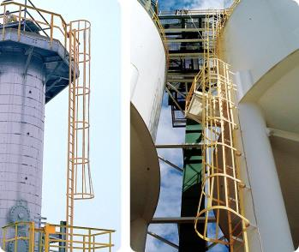
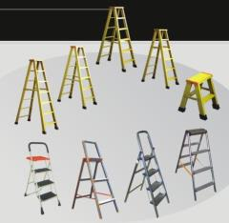
§1910.23
§1910.23 – Ladders.
Consolidates and simplifies rules into general requirements, portable ladders, fixed ladders, and mobile ladder stands
Requires inspection before use
Fixed Ladders
Portable
Ladders and Step Stools

Slide 9
§1910.23
General requirements for all ladders
Ladder surfaces are free of puncture and laceration hazards
Ladders are used only for the purposes for which they were designed
Ladders are inspected before initial use in each work shift, and more frequently as necessary
Any ladder with structural or other defects is immediately tagged “Dangerous: Do Not Use”… and removed from service until repaired… or replaced

Slide 10
§1910.23
General requirements for all ladders (cont.)
Each employee faces the ladder when climbing up or down it
Each employee uses at least one hand to grasp the ladder when climbing up and down it
No employee carries any object or load that could cause the employee to lose balance and fall while climbing up or down the ladder

Slide 11
§1910.23
Portable ladders
Rungs and steps are corrugated, knurled, dimpled, coated with skid-resistant material, treated to minimize the possibility of slipping
Each stepladder or combination ladder used in a stepladder mode is equipped with a metal spreader or locking device that securely holds the front and back sections in an open position while the ladder is in use

Slide 12
§1910.23
Portable ladders (cont.)
Ladders not loaded beyond the maximum intended load
Ladders used only on stable and level surfaces unless they are secured or stabilized to prevent accidental displacement
No ladder moved, shifted, or extended while an employee is on it

Slide 13
§1910.23
Portable ladders (cont.)
Ladders placed in locations such as passageways, doorways, or driveways where they can be displaced by other activities or traffic
Are secured to prevent accidental displacement; or
Are guarded by a temporary barricade, such as a row of traffic cones or caution tape, to keep the activities or traffic away from the ladder
Portable ladders used on slippery surfaces are secured and stabilized

Slide 14
§1910.23
Portable ladders (cont.)
Top of a non-self-supporting ladder is placed so that both side rails are supported, unless the equipped with a single support attachment
Ladders and ladder sections not tied or fastened together to provide added length unless they are specifically designed for such use
Ladders not placed on boxes, barrels, or other unstable bases to obtain additional height

Slide 15
§1910.23
Portable ladders used to gain access to an upper landing surface have side rails that extend at least 3 feet above the upper landing surface

Slide 16
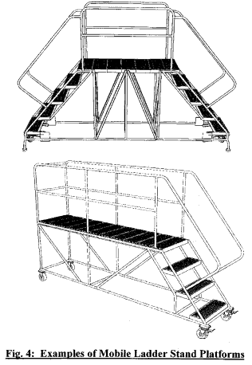
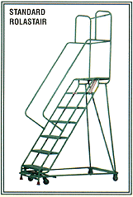
§1910.23
Updates and makes rule consistent with current national consensus standards
Mobile Ladder Stand
Mobile Ladder Stand Platform

Slide 17
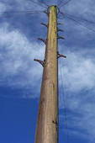
§1910.24
§1910.24 – Stepbolts and manhole steps
Moves stepbolt criteria from OSHA’s Telecommunication Standard to Walking-Working Surfaces
Makes design, inspection, and maintenance requirements consistent with national consensus standards
Step bolts on pole

Slide 18
§1910.25
§1910.25 – Stairways
Adds design and use criteria for spiral stairs, ship stairs, and alternating tread-type stairs
Updates design criteria for stairs and landings, consistent with national consensus standards

Slide 19
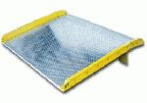
§1910.26
§1910.26 – Dockboards
Updates requirements for dockboards
Adds design and construction requirements to prevent equipment from going over the dockboard edge

Slide 20
§1910.27
§1910.27 – Scaffolds and Rope Descent Systems (RDS)
Requires that employers using scaffolds follow the construction standard
Adds provision allowing use of RDS, which codifies a 1991 OSHA memo allowing RDS
Requires certification of anchorages starting 1 year after final rule published
Requires RDS have separate fall arrest system

Slide 21
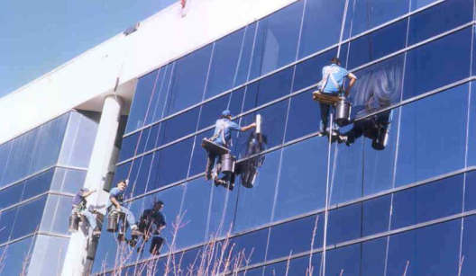
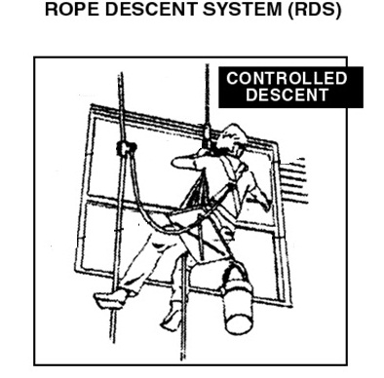
Rope Descent Systems

Slide 22
§1910.28
§1910.28 – Duty to have fall protection and falling object protection
Consolidates general industry fall protection requirements into one section
Makes requirements and format consistent with construction standard
Incorporates new technology that is consistent with national consensus standards
Gives employers flexibility to use the system that works best to protect workers in their situation

Slide 23
§1910.28
Walking-working surface with an unprotected side or edge that is 4 feet or more above a lower level protected from falling :
Hoisting areas
Holes (skylights)
Dockboards
Dangerous equipment (less than and greater than 4’)
Openings

Slide 24
§1910.28
General (unprotected sides and edges)
Guardrail systems
Safety net systems
Personal fall protection systems, such as personal fall arrest, travel restraint, or positioning systems

Slide 25
§1910.28
Hoisting Areas
Guardrail systems
A personal fall arrest system
A travel restraint system
Notes:
Hoist area means any elevated access opening to a walking-working surface through which equipment or materials are loaded or received.

Slide 26
§1910.28
Holes
Covers
Guardrail systems
Travel restraint systems
Personal fall arrest systems
Notes:
Hole means a gap or open space in a floor, roof, horizontal walking-working surface, or similar surface that is at least 2 inches (5 cm) in its least dimension.

Slide 27
§1910.28
Dockboards
Guardrail system or handrails
Guardrail system or handrails are not required when:
Dockboards are used solely for materials-handling operations using motorized equipment;
Employees engaged in these operations are not exposed to fall hazards greater than 10 feet; and
Those employees have been trained in accordance with §1910.30.

Slide 28
§1910.28
Runways and similar walkways
Guardrail system

Slide 29
§1910.28
Dangerous equipment
Less than 4 feet above dangerous equipment - protected by a guardrail system or a travel restraint system, unless the equipment is covered or guarded to eliminate the hazard
4 feet or more above dangerous equipment must be protected from a fall:
Guardrail systems
Safety net systems
Travel restraint systems
Personal fall arrest systems

Slide 30
§1910.28
Openings
Where the inside bottom edge of the opening is less than 39 inches above that walking-working surface and the outside bottom edge of the opening is 4 feet or more above a lower level is protected from falling by the use of:
Guardrail systems
Safety net systems
Travel restraint systems
Personal fall arrest systems

Slide 31
§1910.28
Other
Repair pits, service pits, and assembly pits less than 10 feet in depth
Fixed ladders (that extend more than 24 above a lower level)
Outdoor advertising (billboards)
Stairways
Scaffolds and rope descent systems
Slaughtering Facility Platforms
Walking-working surfaces not otherwise addressed
Protection from Falling objects

Slide 32
§1910.29
§1910.29 – Fall protection systems criteria
Specifies design and installation requirements of each fall protection system available to employers including:
Guardrails
Stair rails
Designated areas
Safety nets
Covers
Cages and wells
Ladder safety systems
Toeboards

Slide 33
§1910.30
§1910.30 – Training
Adds training and retraining requirements addressing fall hazards and equipment hazards
Requires employers make training understandable to workers

Slide 34
§1910.30
Before any employee is exposed to a fall hazard, the employer must provide training for each employee who uses personal fall protection systems or who is required to be trained as specified elsewhere in this subpart. Employers must ensure employees are trained in the requirements of this paragraph on or before May 17, 2017

Slide 35
Must train each employee in at least the following topics:
Nature of the fall hazards and how to recognize them;
Procedures to be followed to minimize those hazards;
Correct procedures for installing, inspecting, operating, maintaining, and disassembling the personal fall protection systems that the employee uses; and
Correct use of personal fall protection systems and equipment, including, but not limited to, proper hook-up, anchoring, and tie-off techniques, and methods of equipment inspection and storage, as specified by the manufacturer.

Slide 36
§1910.30
Equipment hazards
Proper care, inspection, storage, and use of equipment covered by this subpart before an employee uses the equipment.
Must train each employee who uses a dockboard to properly place and secure it to prevent unintentional movement.
Must train each employee who uses a rope descent system
Must train each employee who uses a designated area in the proper set-up and use of the area.

Slide 37
§1910.30
Retraining
Situations requiring retraining include, but are not limited to, the following:
Changes in the workplace render previous training obsolete or inadequate;
Changes in the types of fall protection systems or equipment to be used render previous training obsolete or inadequate; or
When inadequacies in an affected employee's knowledge or use of fall protection systems or equipment indicate that the employee no longer has the requisite understanding or skill necessary to use equipment or perform the job safely.

Slide 38
§1910.140
§1910.140 – Personal Protective Equipment (Personal Fall Protection Systems)
Adds definitions for personal fall protection systems
Adds new section on system and use criteria for:
Personal fall protection equipment (e.g., lanyards, ropes, D-rings, harnesses)
Personal fall arrest systems
Travel restraint systems
Work positioning systems

Slide 39
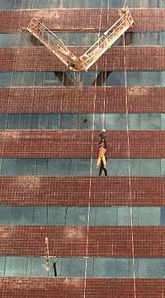
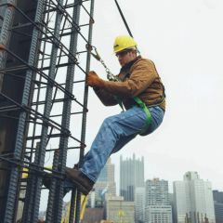
Personal Fall Protection
Work Positioning
Travel Restraint
Personal Fall Arrest

Slide 40
Major Changes
Fall Protection Flexibility
Updated Scaffold Requirements
Phase-in of ladder safety systems or personal fall arrest systems on fixed ladders
Phase-out of “qualified climbers” on outdoor advertising structures
Rope descent systems
Adds requirements for personal fall protection equipment (final §1910.140)
Adds training requirements

Slide 41
Main Effective Dates
Published: November 18, 2016
Rule overall: January 17, 2017
Training: 6 months after publication
Building anchorages for RDS: 1 year after publication
Fixed ladder fall protection: 2 years after publication
Installation of ladder safety system or personal fall arrest system on fixed ladders: 20 years after publication

Slide 42
Compliance Assistance Resources
OSHA’s new webpage on subparts D&I: www.osha.gov/walking-working-surfaces/index.html
Fact sheets
FAQs

Slide 43
Compliance Assistance Resources
OSHA’s new webpage on subparts D&I: www.osha.gov/walking-working-surfaces/index.html
Fact sheets
FAQs

